Slide 1

Property Tax Cap Calculation for 2019 - 2020
Central Square Central School District
February 11, 2019

Slide 2
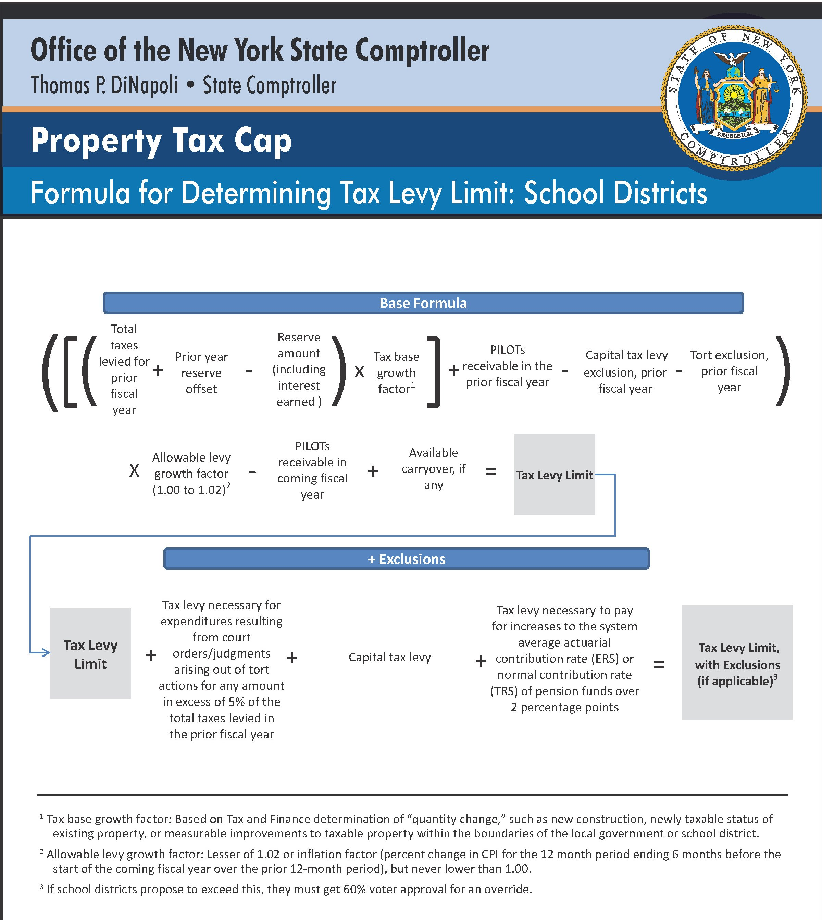

Slide 3
PROPOSED TAX LEVY LIMIT
Proposed Tax Levy Limit – Before Exemptions
 | Real Property Tax Levy 2018 – 2019 |  | $28,066,912
Multiply: | Tax Base Growth Factor | x | 1.0084
 | sub-total | = | $28,302,674
Adjust for: | PILOTS for 2018-2019 | + | $2,521
 | Capital Tax Levy Exclusion | - | ($487,415)
 | Adjusted 2017 – 2018 Current Year Tax Levy | = | $27,817,780
Multiply: | Less of 2% or CPI (CPI = 2.44%) | x | 1.0200
 | sub-total | = | $28,374,136
Adjust for: | Projected PILOTS for 2018 – 2019 | - | ($2,521)
 | PROPOSED 2018 – 2019 TAX LEVY LIMIT | = | $28,371,615
*Submit to Comptroller by 3.1.19

Slide 4
MAXIMUM ALLOWABLE TAX LEVY
Proposed Tax Levy Limit – Exemptions
 | Proposed 2019 – 2020 Tax Levy Limit |  | $28,371,615
Adjust for: | Capital Tax Levy Exclusions | + | 457,672
 | MAXIMUM ALLOWABLE TAX LEVY | = | $28,829,287 | 2.72%
*Submit to Comptroller by 3.1.19

Slide 5

on a $100,000 home & a tax levy increase of…
2.72%
$19.32 | 2019-20 | *Estimated tax rate per thousand
$18.81 | 2018-19 | Current tax rate per thousand
.51 | Increase per thousand
or $51.00**
*Assuming the Town Assessment and Equalization Rate are unchanged.

